Slide 1
ProjectWise Drive and MicroStation Workspaces
Solution Engineering Team

Slide 2
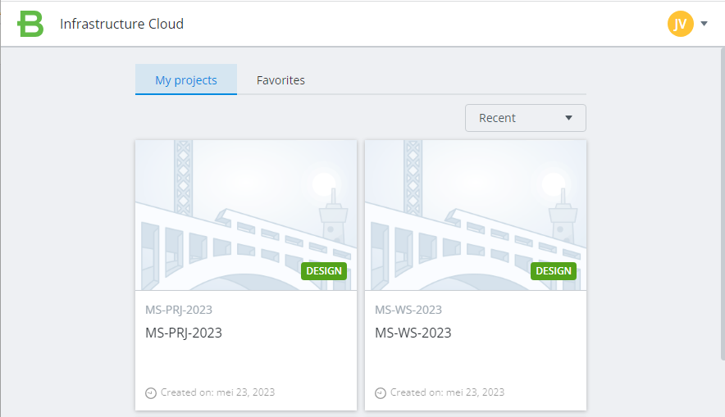
Setup project(s)
Design
Project
Workspace
Project

Slide 3
Design Project

Slide 4
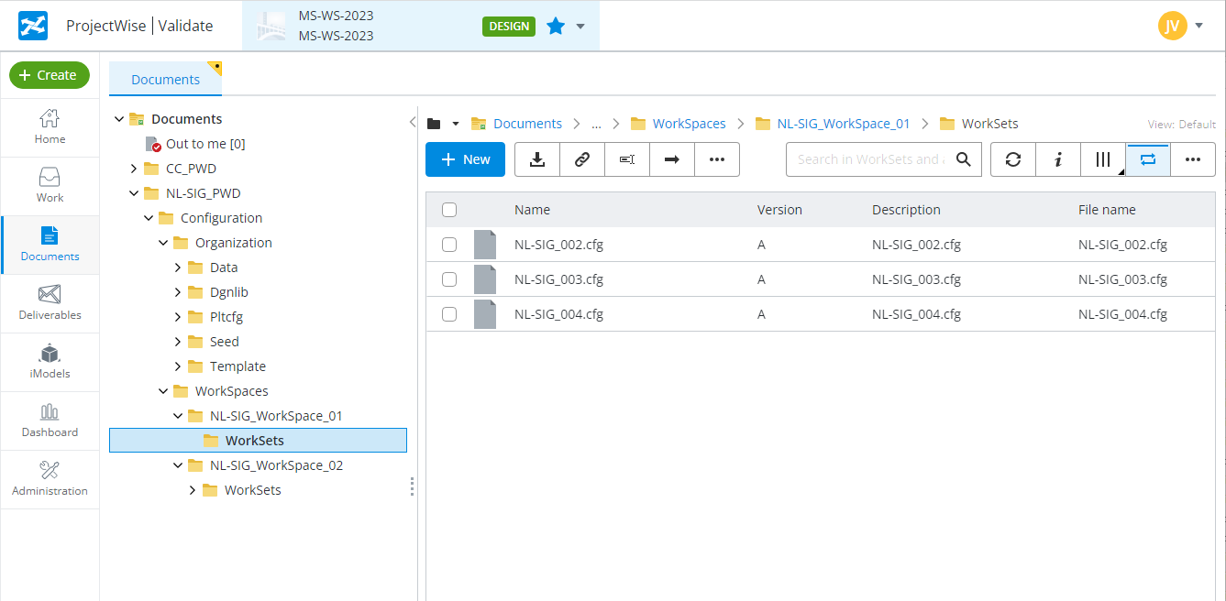
Workspace project

Slide 5
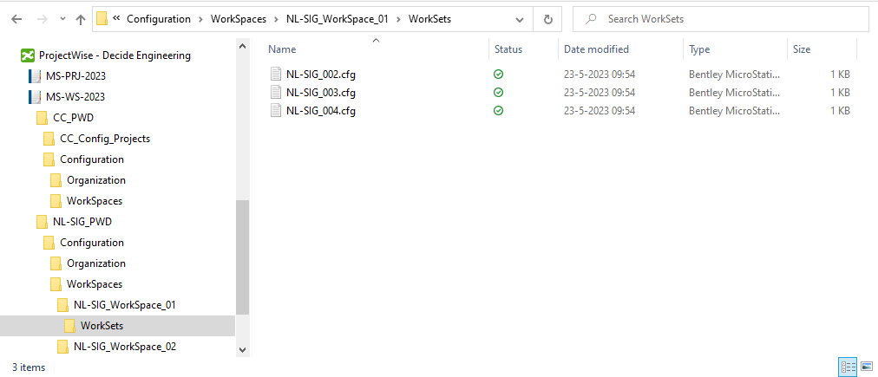
ProjectWise Drive – Windows Explorer view

Slide 6
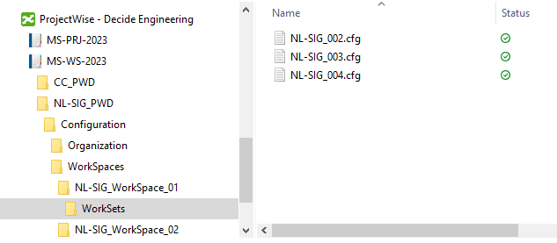
ProjectWise Drive – integration with MicroStation 17.1 / 17.2
Setup tasks:
Prepare a ProjectWise work area with the MicroStation workspace.
Example: MS-WS-2023
Enable ProjectWise Drive
MicroStation / Bentley View 17.x. add a configuration with ProjectWise Drive
Select the folder where the Workspaces are stored

Slide 7
MicroStation Workspace configuration

Slide 8
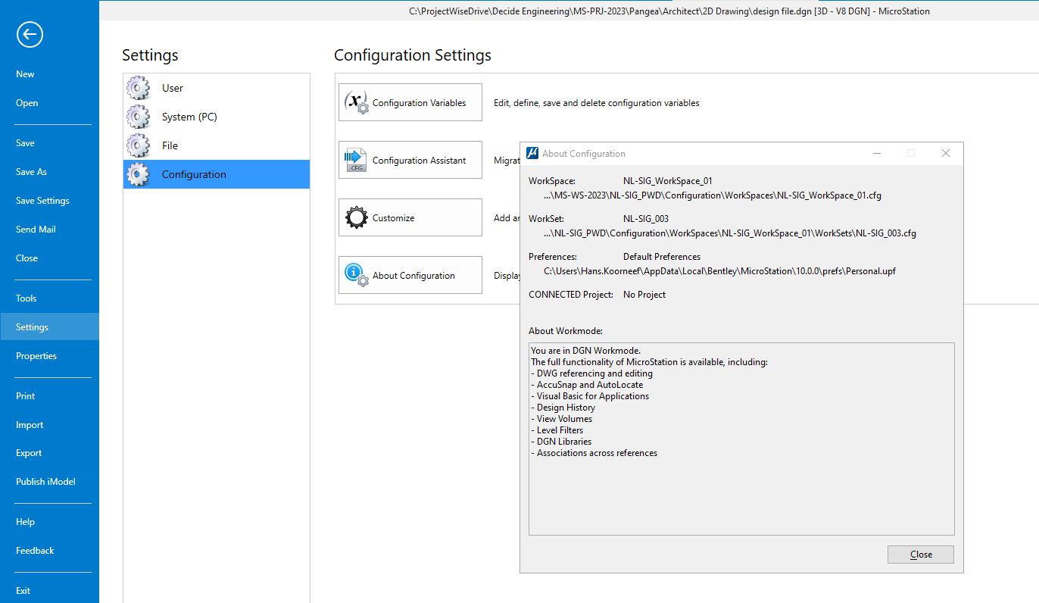

Slide 10
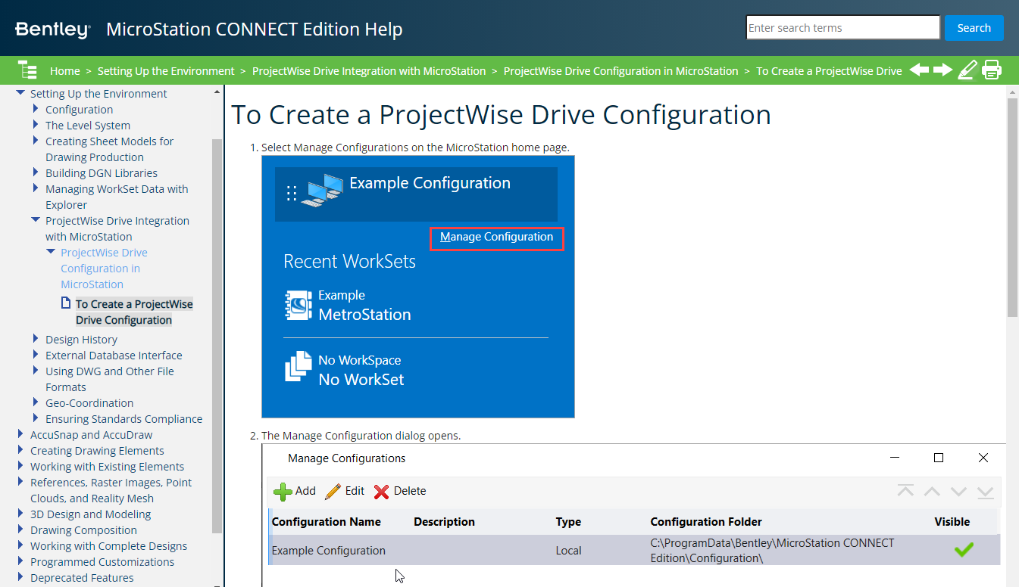
MicroStation help Guide
on docs.Bentley.com

