Slide 1
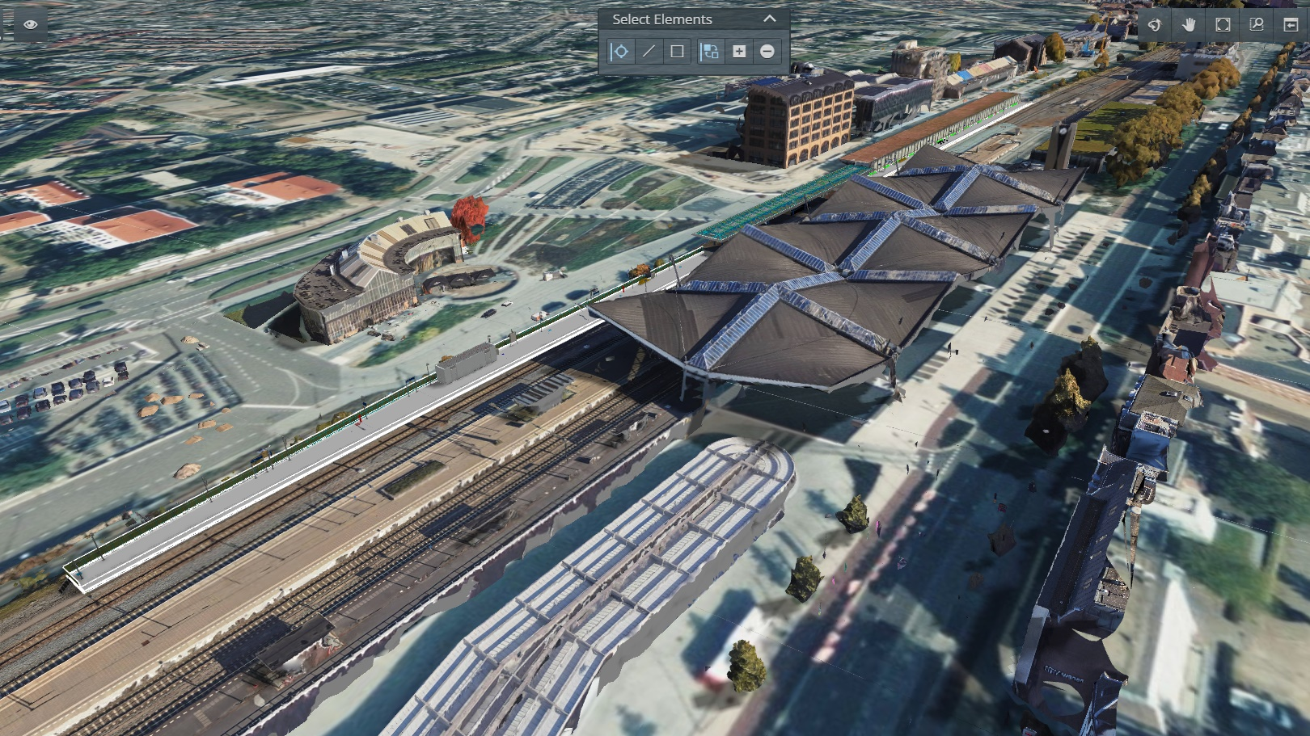


Tilburg 4e perron
Sweco Rail & Stations
Christiaan Post
29 November 2023

Slide 2
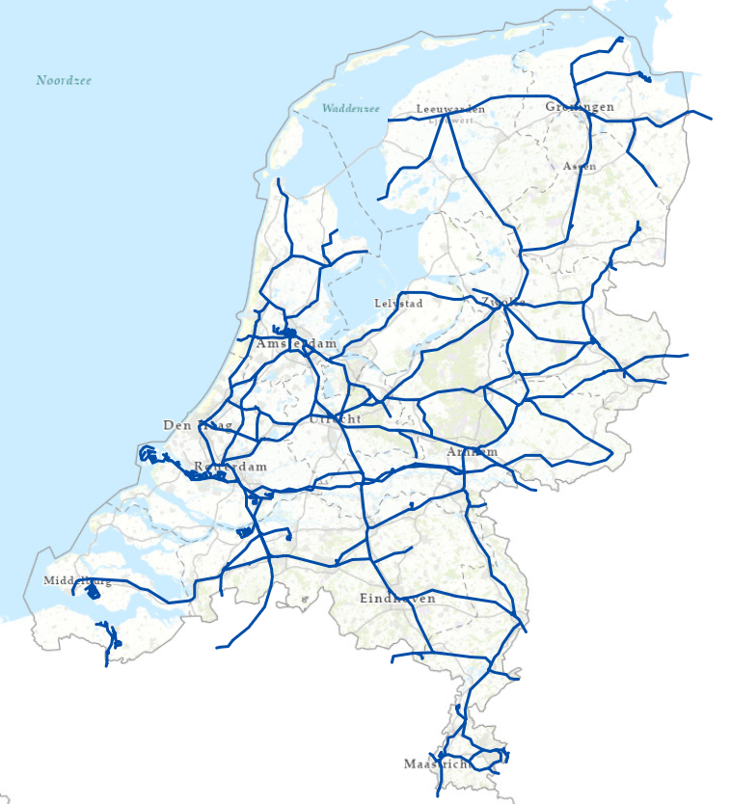
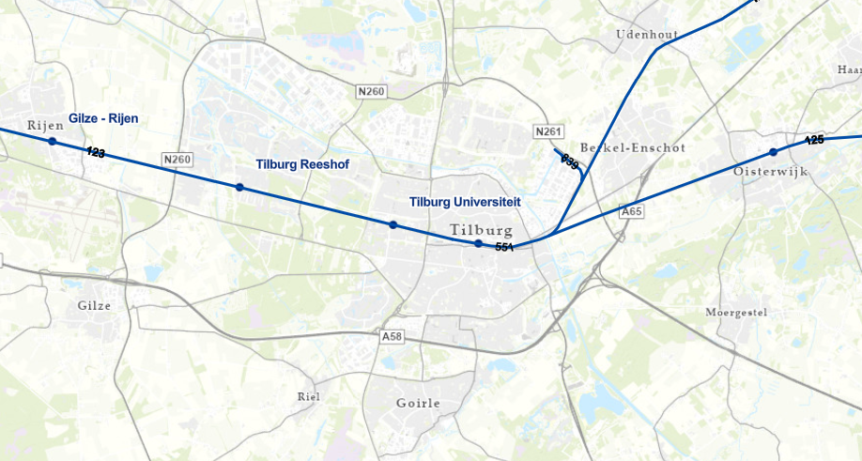
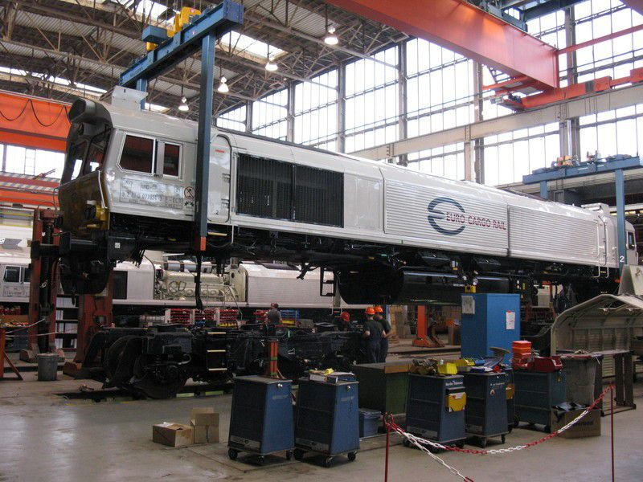
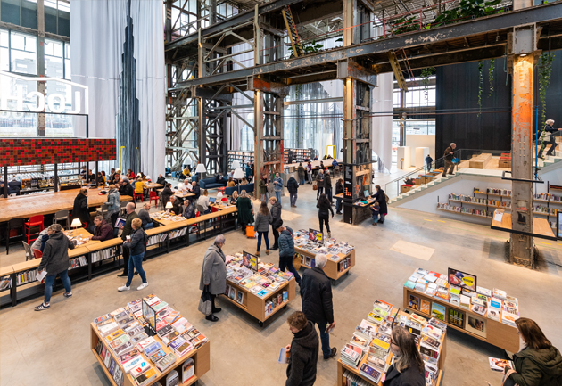

Slide 3
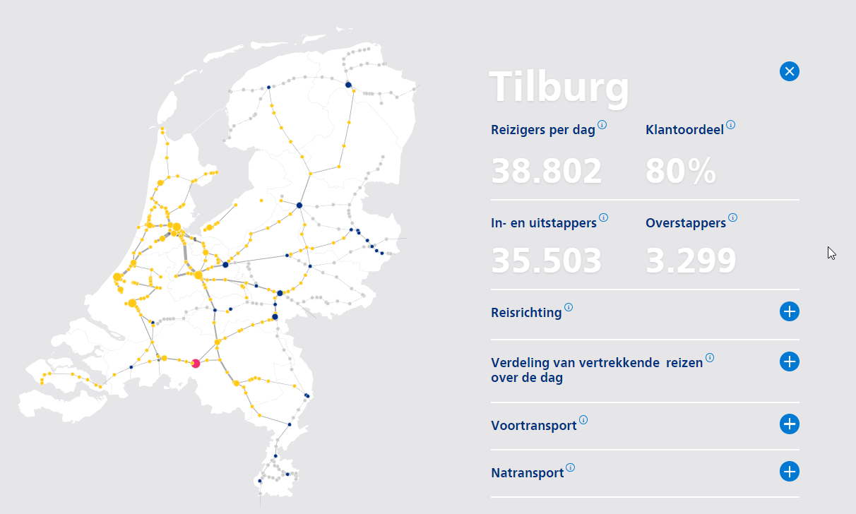





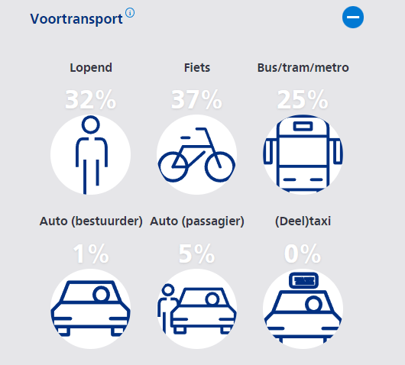
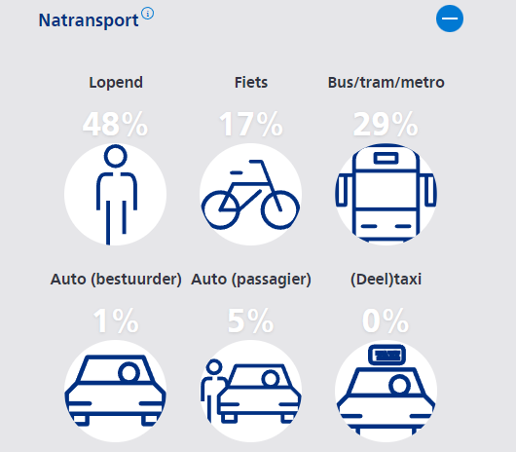
Travelers per day
Boarding and disembarking
Switch to other transport

Slide 4
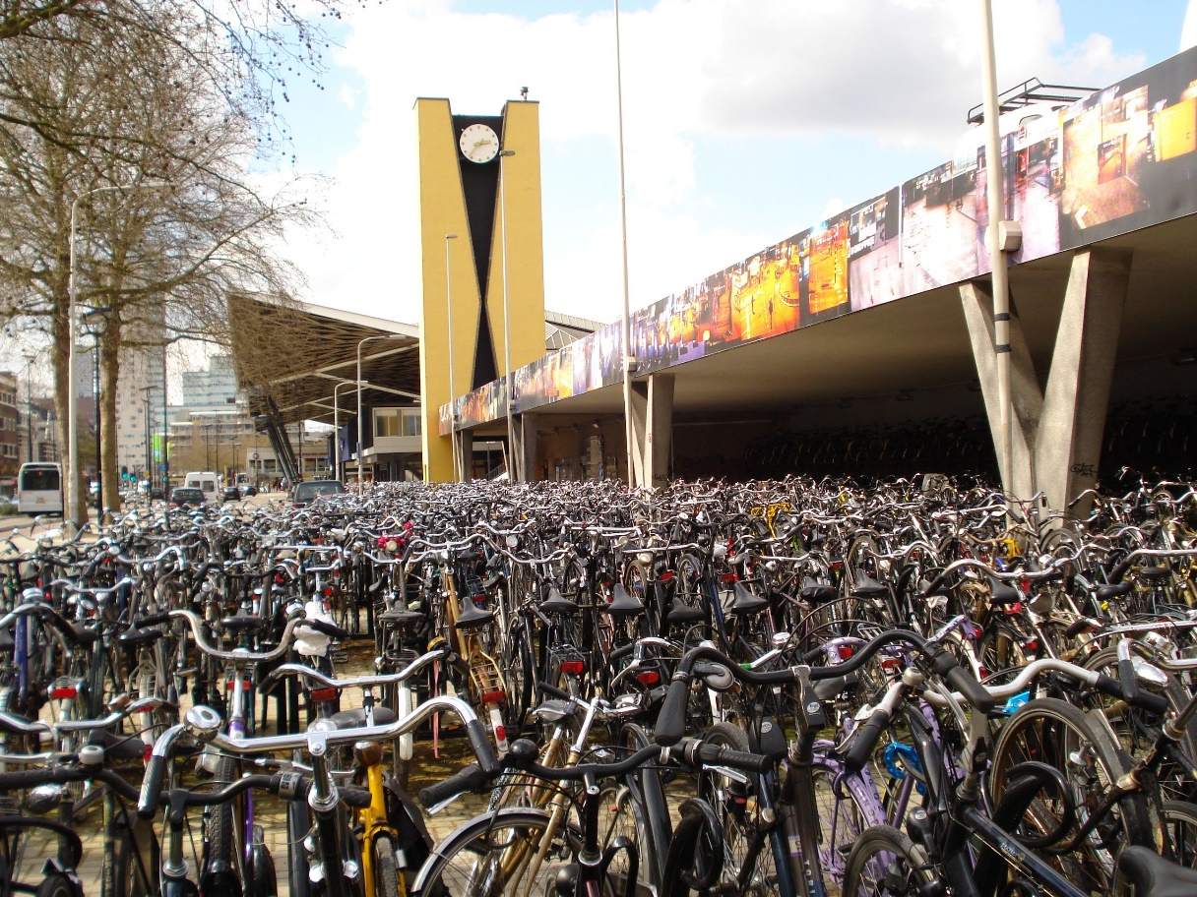
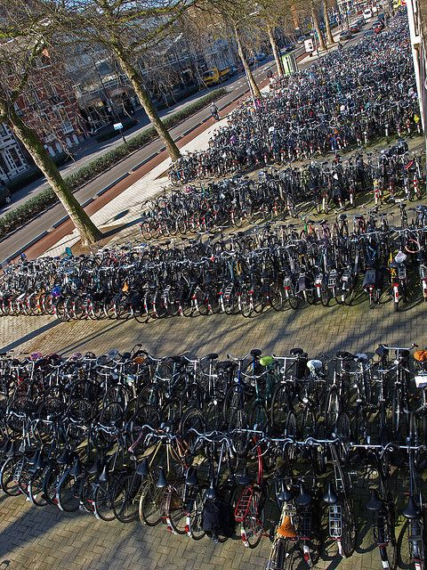
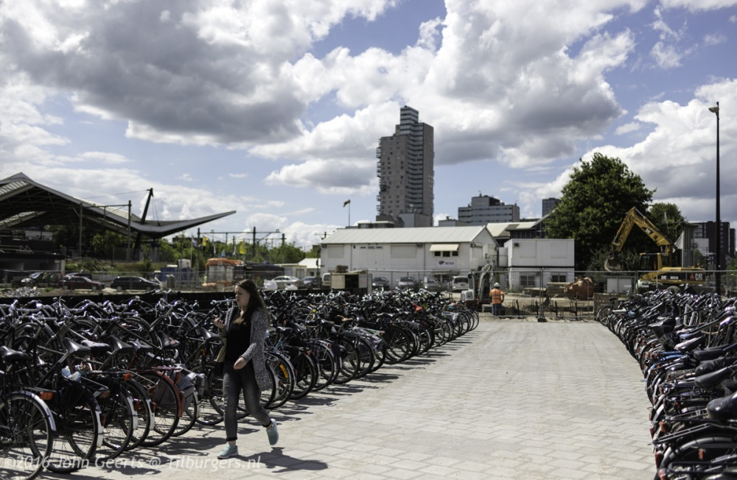

Slide 5
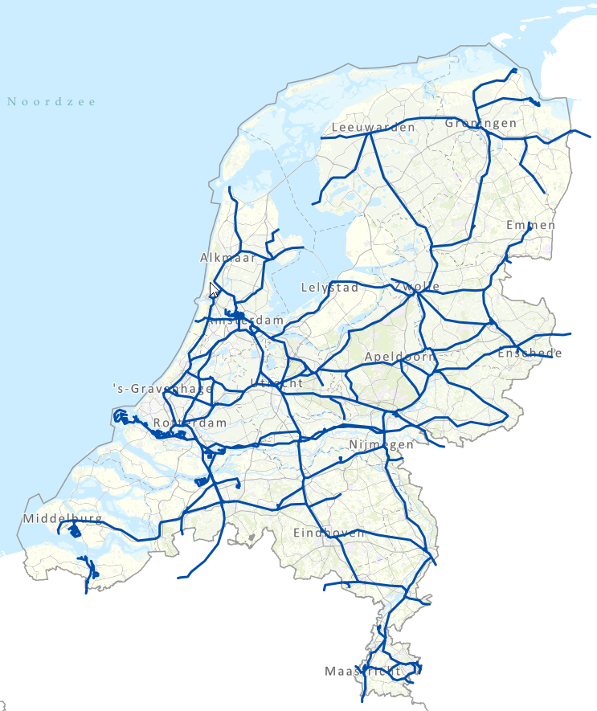
Spoorlengte Km: ca. 7500
Aantal wissels: ca. 6200
Aantal seinen: ca. 12.000
Aantal stations: 399
ca. 7500
ca. 6200
ca. 12.000
399

Slide 6
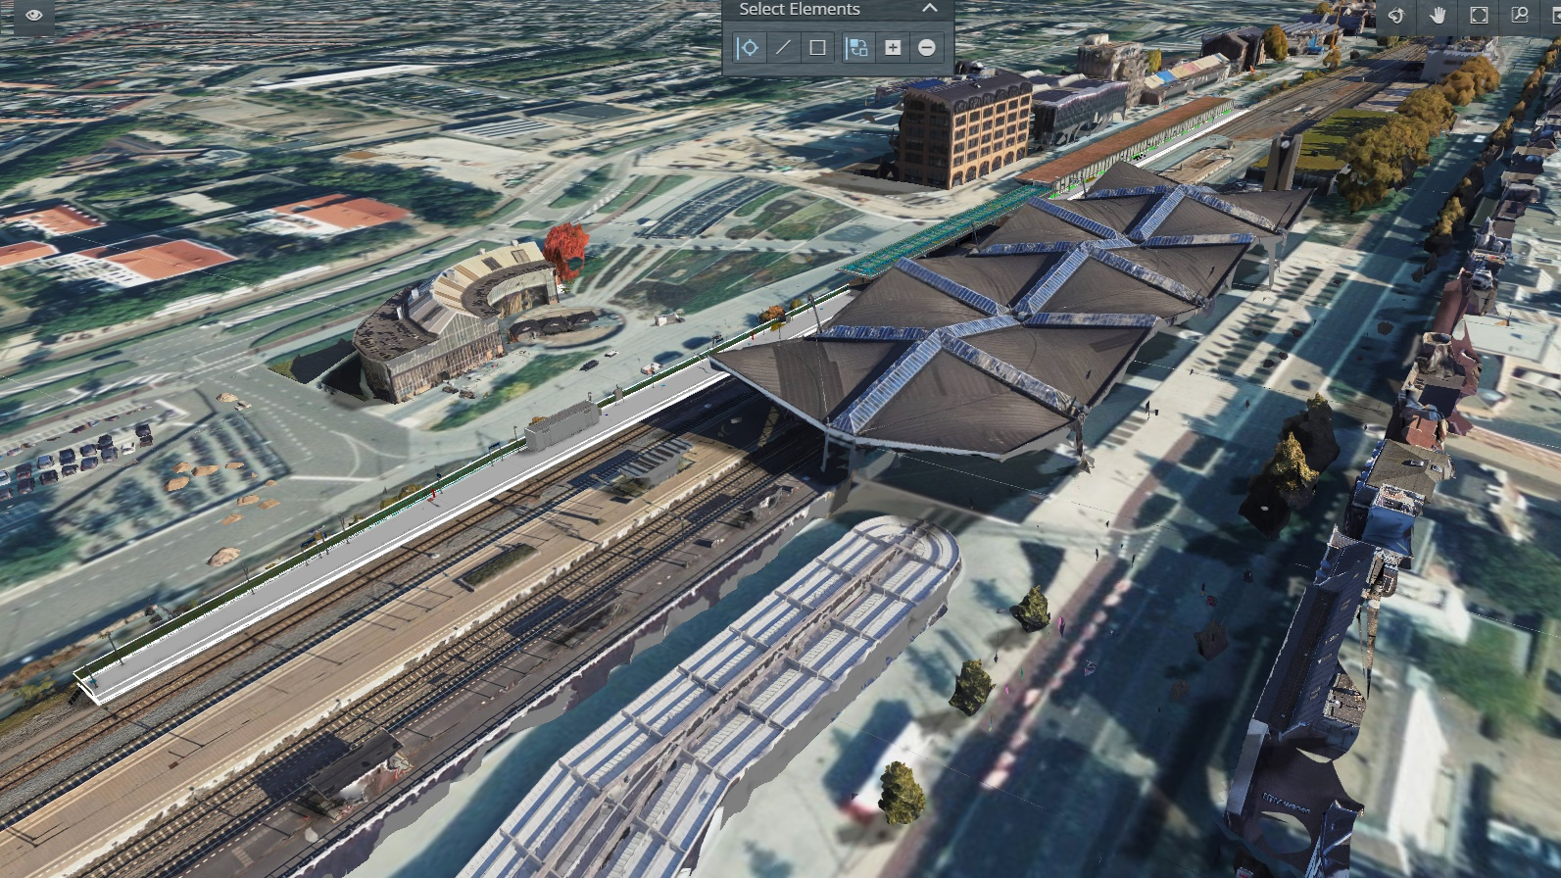

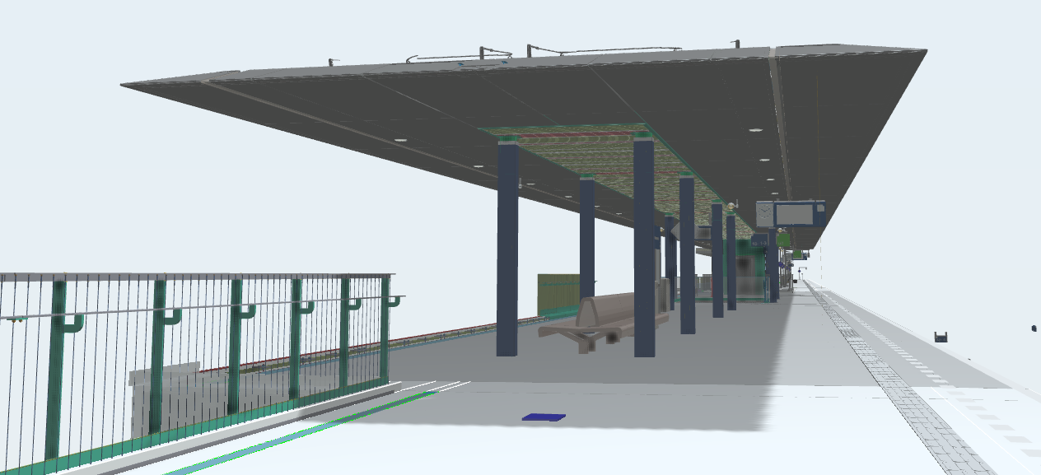
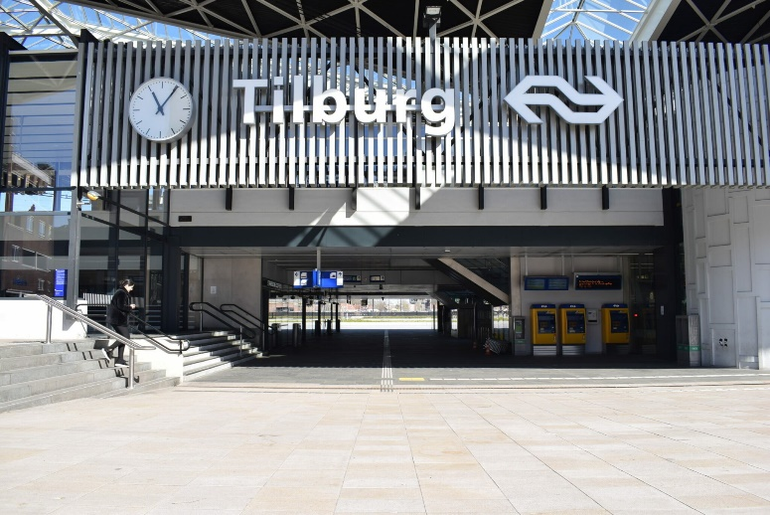

Slide 7
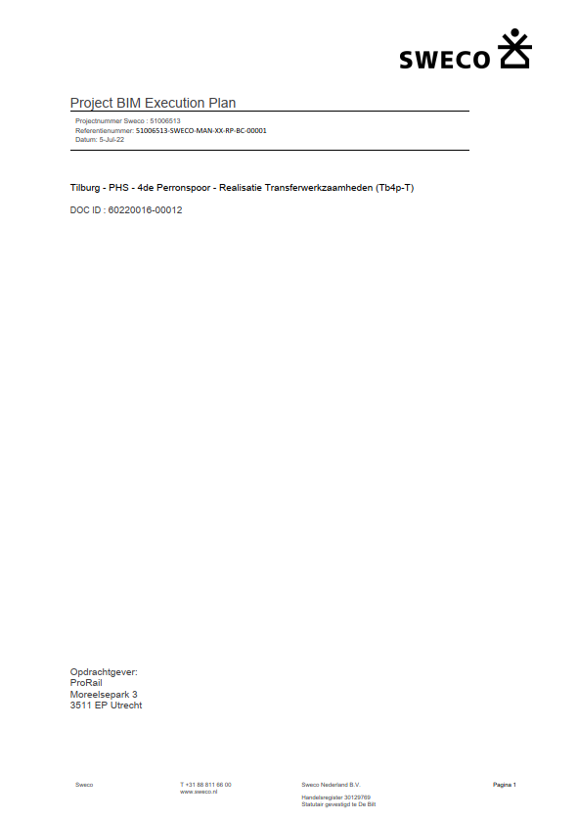
BIM Execution Plan (BEP)
51006513-SWECO-MAN-XX-RP-BC-00001-P03.pdf

Slide 8
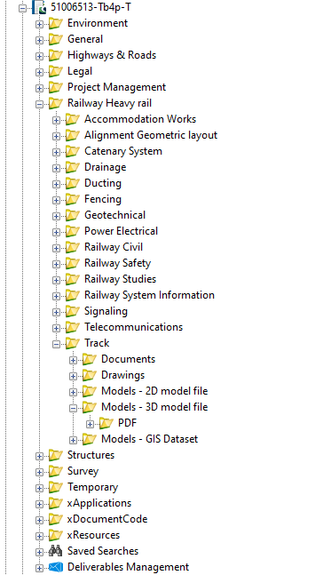

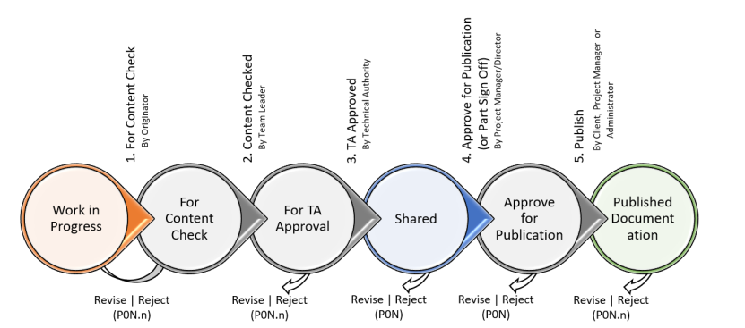
Voordelen Projectwise
Gebaseerd op BS1192 en ISO19650
Informatie continue beschikbaar
Centrale opslag locatie (SSOT)
Workflow om de kwaliteit te waarborgen

Slide 9
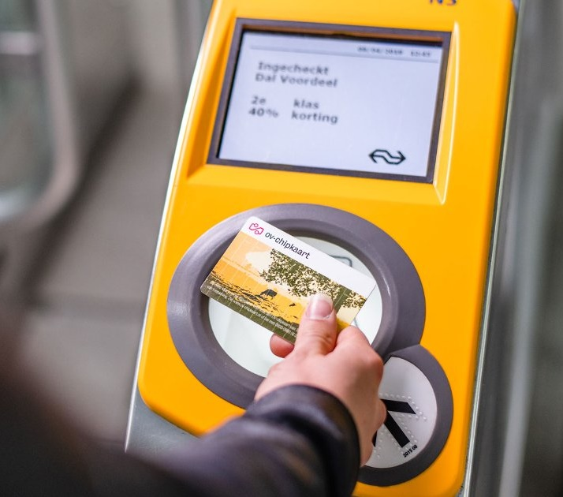
Het concept is simpel!

Slide 10
ISO19650 @Sweco Nederland
Gebiedsadvies
Urban planning
Bureau Stedelijke Planning
CITY AND ENVIRONMENT
ISO19650 Kitemark Certified
Environmental Consultancy
Environmental Consultancy
Civil projects
Building Services
Urban Projects
Water technology
Roads & highways
Water
Energy & Sustainability
Building
hydraulic engineering
WATER EN ENERGY
Industry
GIS & ICT
Mobility
Real estate
Rail & Stations
Capital
Consultants
TRANSPORT EN MOBILITY

Slide 11
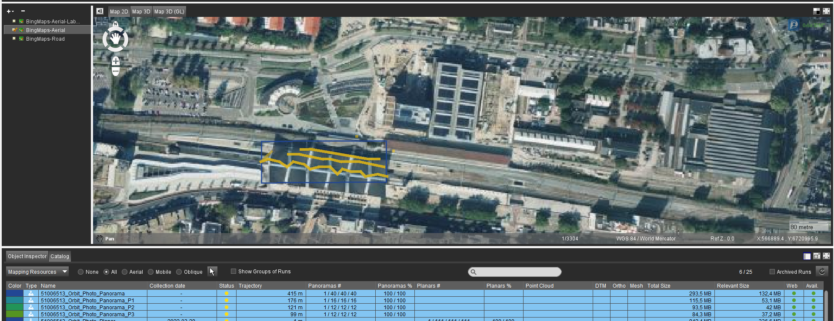
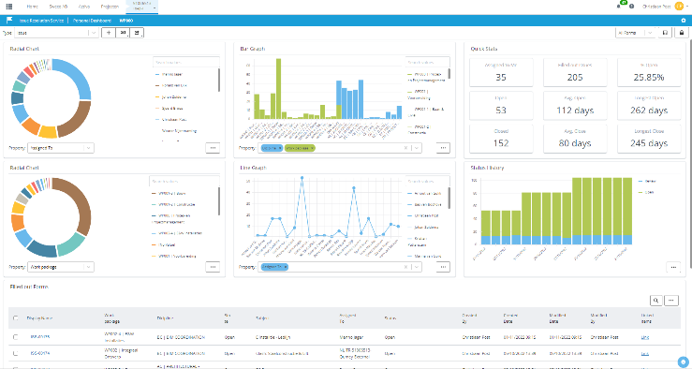
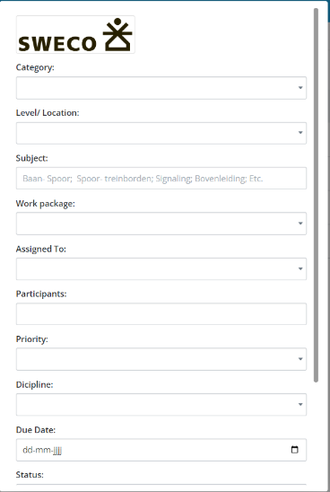
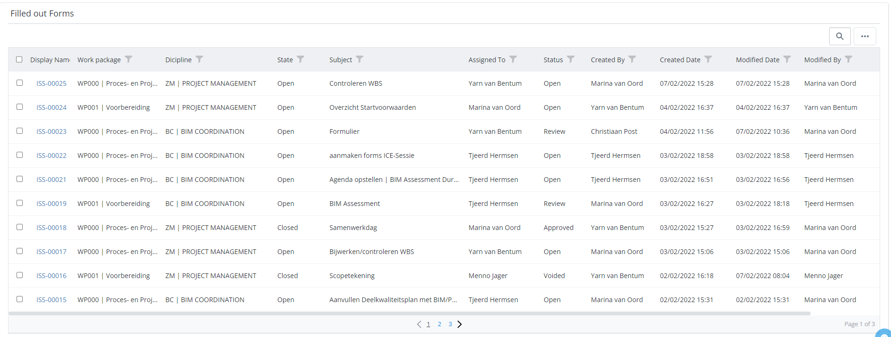
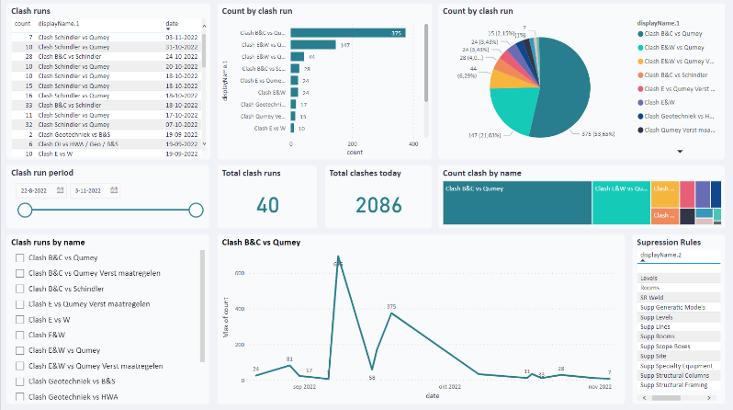
Bentley Cloud services
iTwin Capture Modeler
iTwin Import & Upload tool
Issue resolution
Forms | voor verschillende disciplines | intern & extern
Clash detection
Power BI dashboard

Slide 12
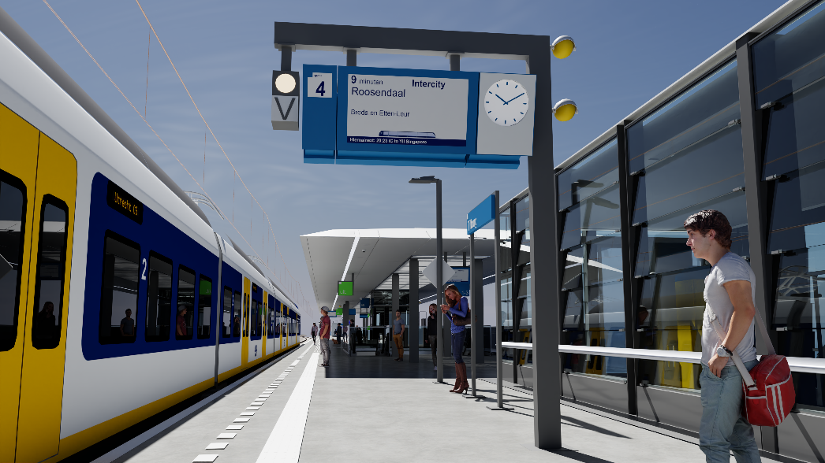
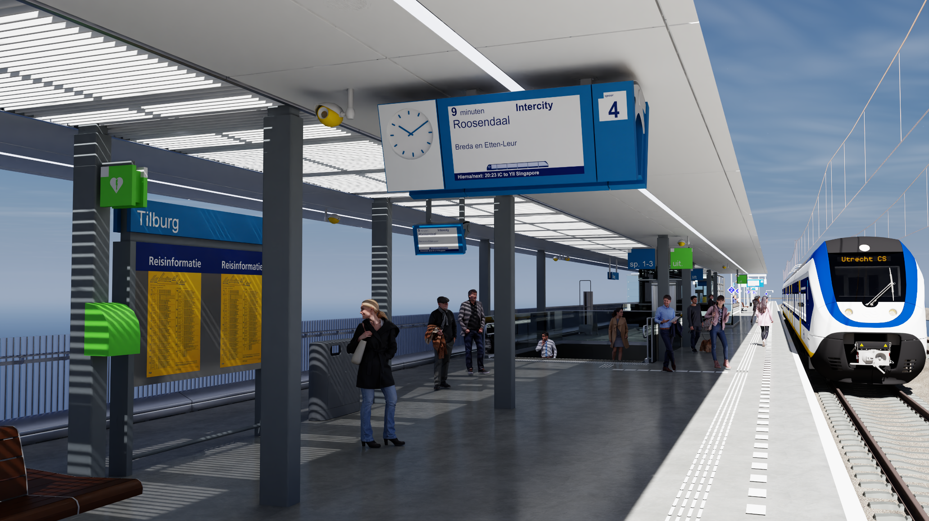
LumenRT for NVIDEA Omniverse

Slide 13
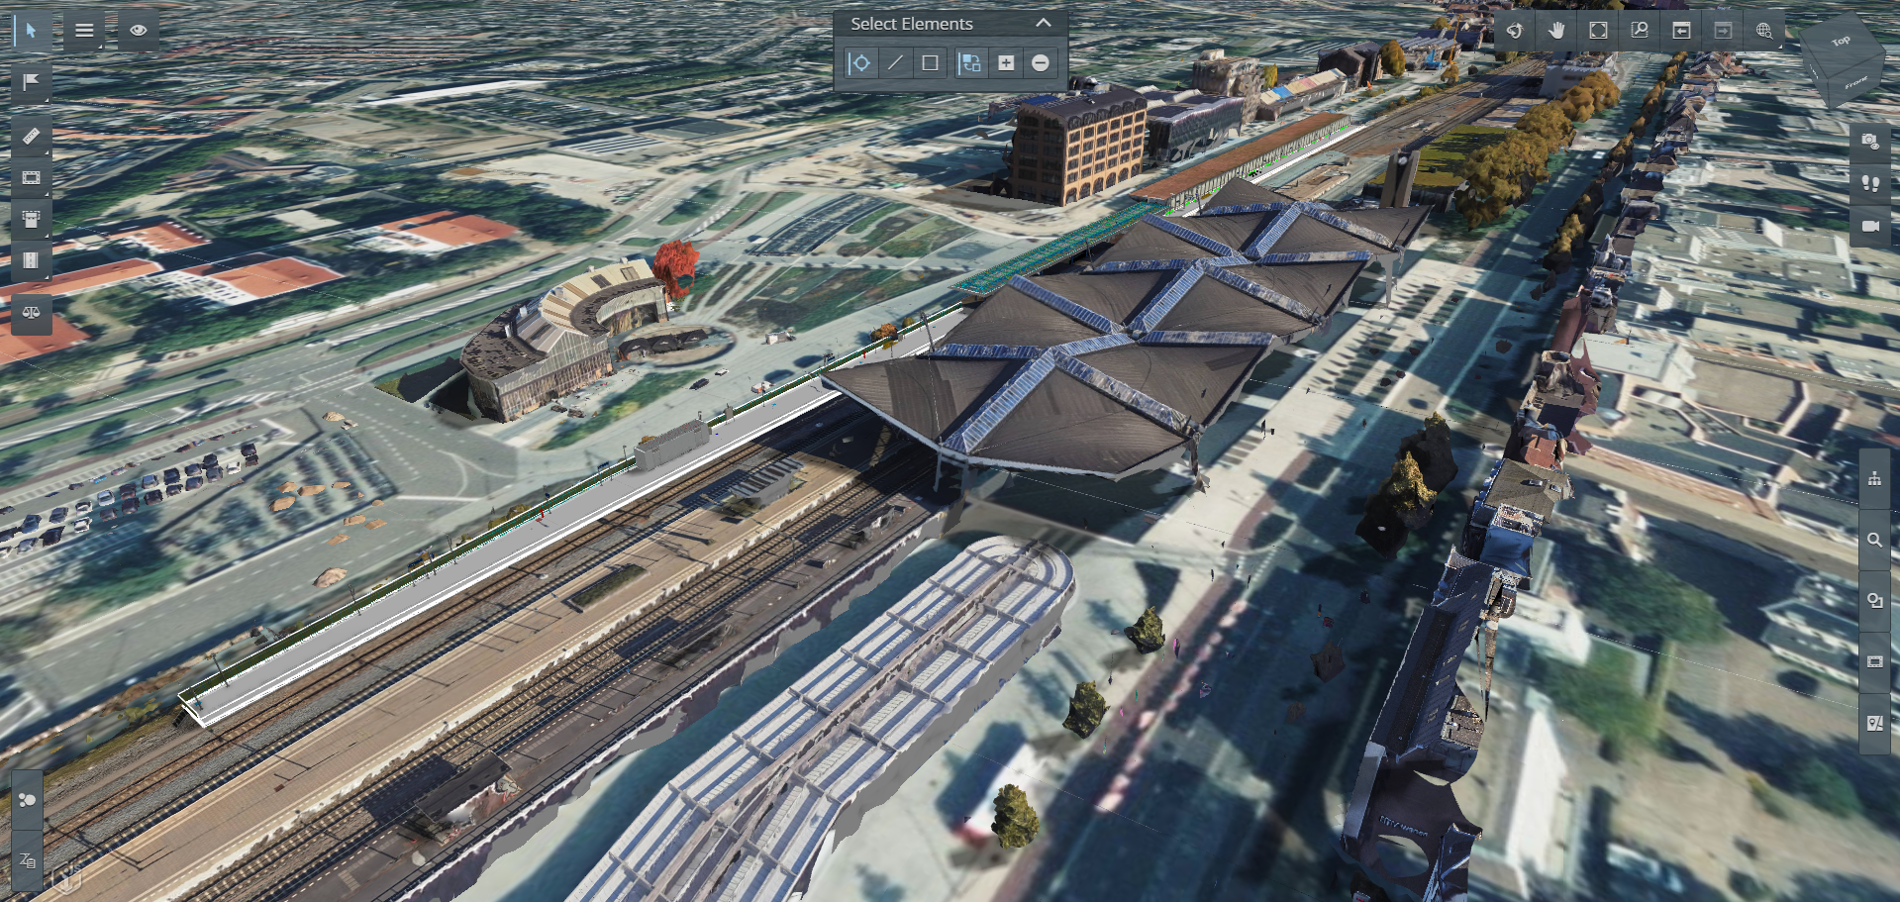
Live demo

Slide 14
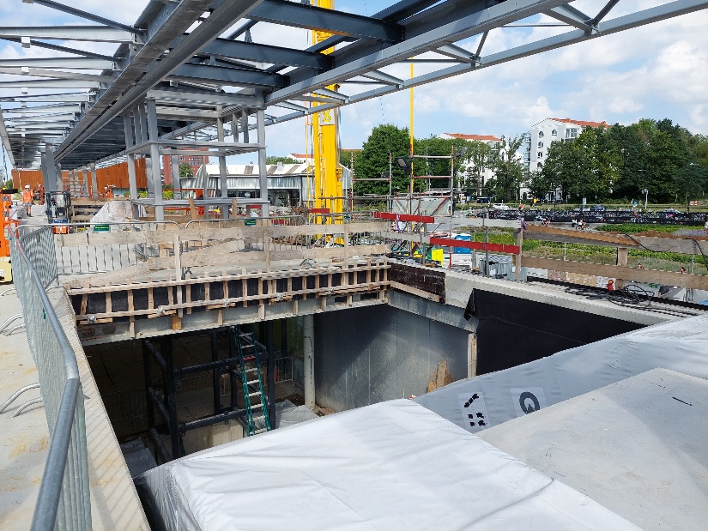
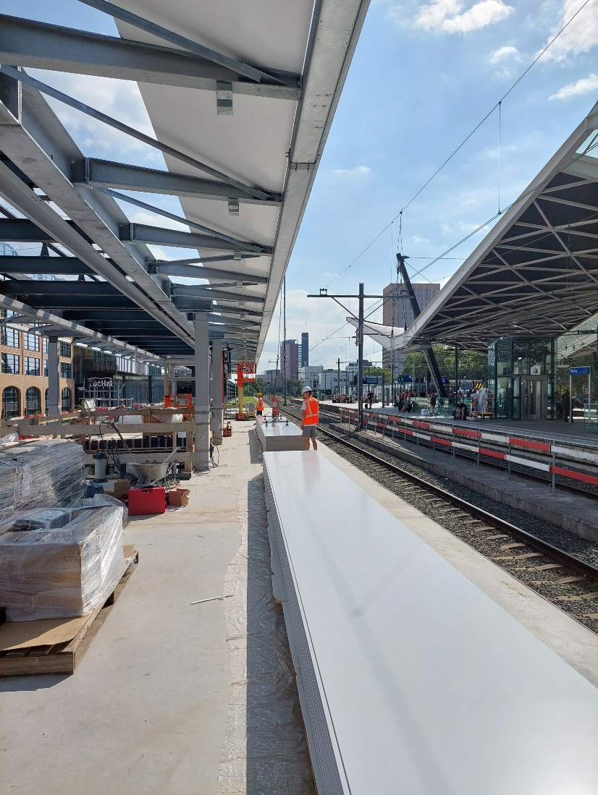
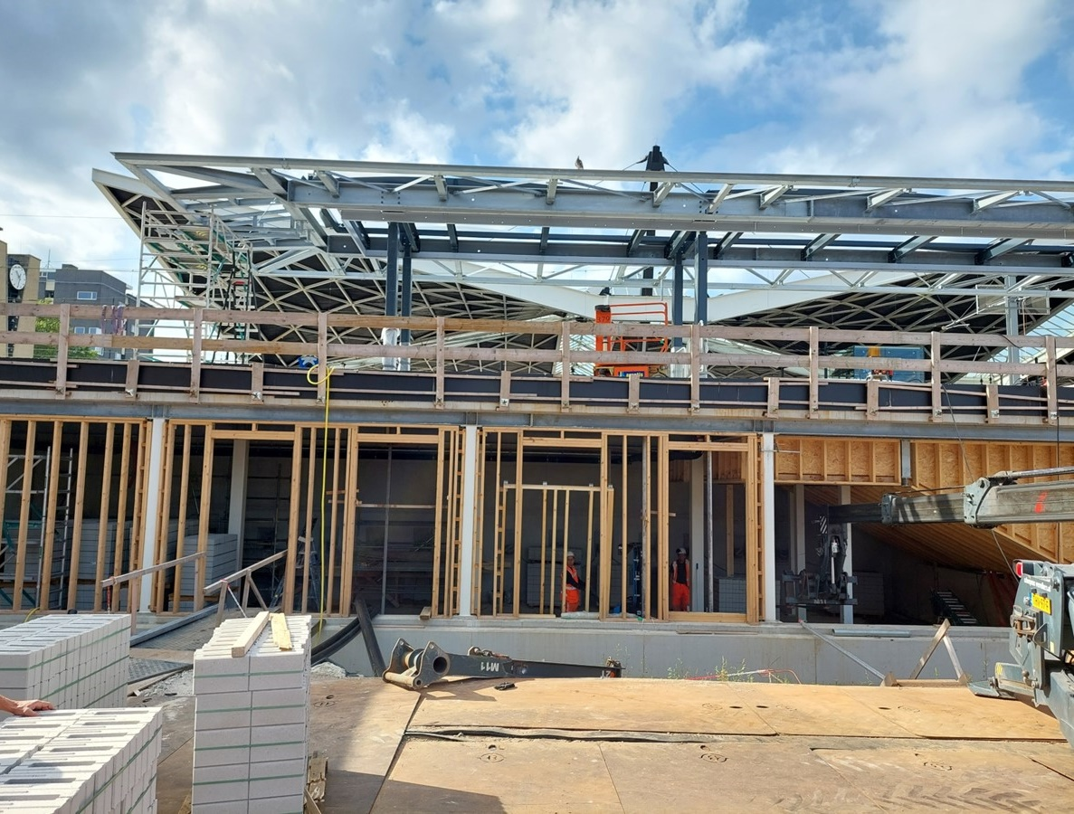
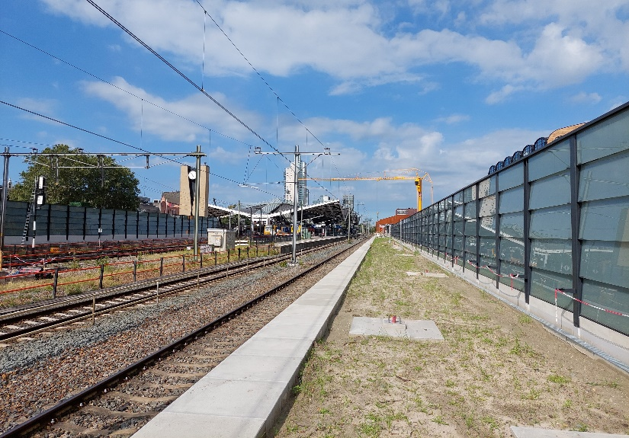
Realisatie

