Slide 1
MicroStation
Feedback session with Bentley
Mark Stals - TMC Ambassadeur
Christiaan Post - TMC bestuur

Slide 2
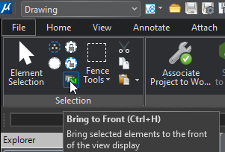
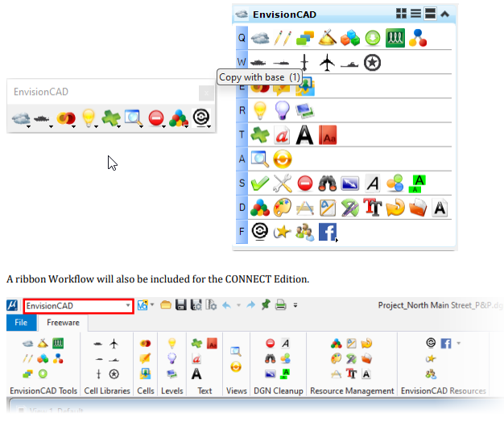
Send to Back (3)
We miss the “send to back” button, currently there is only the “bring to front” button.
Envisioncad heeft een mooie plug-in als aanvulling op MicroStation
https://envisioncad.com/freeware/microstation-resources/

Slide 3
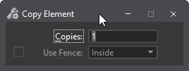
Copy with base (1)
In AutoCad it is possible to use the Copy Base command. You can use this command to copy elements with a “base point”. Afterwards you can immediately place the element in the correct location with paste. This is also possible from one file to another file.
Add a thick box to copy with Base point

Slide 4
Drag PW DGN file to ref dialog (2)
Dragging PW dgn inside the reference dialog window.
Linking a reference file from ProjectWise Explorer is currently done via the "attach reference" command We would appreciate it if it were possible to drag a file directly from ProjectWise Explorer into the MicroStation Reference.

Slide 5
Update reference doesn’t work (1)
Update priority of elements in referenced models
A design in a Design Model is linked as a reference in a Sheet Model. If we change the priority of a layer in the Design Model, this attribute change is not automatically applied to the Sheet Model. The only solution is to unlink the reference and relink it. Reloading does not work either, because no line has actually been changed.

Slide 6
Changing level attributes when using a level filter (1)
It is not possible to change a level attribute when using a level filter.
Only from the level manager

Slide 7
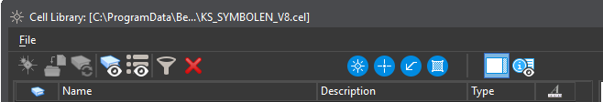
Make full path visible in Cell Library dialog (3)
Make the full path of the attached cell library visible in the title of the cell library (with a variable?)

Slide 8
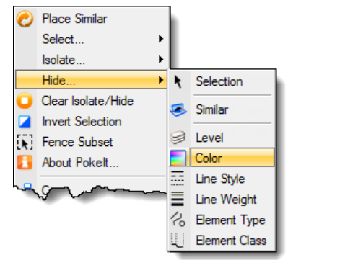
Select similar (1)
This function is currently only available via Poke-lt selector.vba and adds this option to the right-click menu (awkwardly hidden). Can this option be added by default to the selection tools?
https://bentleysystems.service-now.com/community?id=community_question&sys_id=166e30a247adce109091861f536d43f8

Slide 9
Object snap tracking (2)
I often hear from new colleagues who are familiar with AutoCAD that they miss the Object snap tracking functionality in MicroStation.
With AccuDraw shortcuts O + Enter + RE you can get quite far, but it is difficult to learn, and not all (dotted line) actions can be performed.

Slide 10
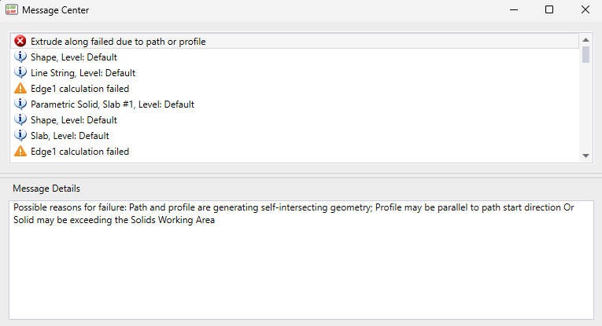
Add Solid Working Area check tool (4)
Create a tool that can make the Solid Working Area visible
Make a tick in View Attributes to turn on/off the Solid Working Area

Slide 11
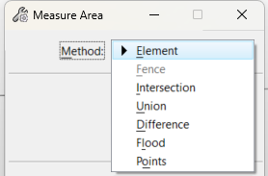

Change Measure Area dropdown menu to icons (3)
Only for Measure Area is the dropdown menu still available, while for Hatch, Pattern, and Create Region these are clear icons. Change the dropdown menu to icons.

Slide 12
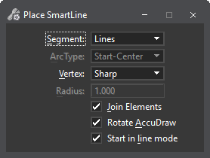
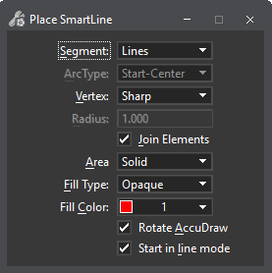
Place Smartline Close (1)
To switch within Place SmartLine between Fill Type Opaque or None you have to provide a tentative point to keep the Tool setting “open.” That is very inconvenient. Just make it a switch.
Make the Area, Fill Type and Fill Color option available

Slide 13
Create Legend (4)
Outside the solar study, no possibility to create a legend.
A legend maker with options for line type, hatching, or color, for example. Look at the competitors.

Slide 14
Equal distance objects / text (3)
With the Align command, objects can be aligned, but there is no function to move multiple objects at once based on their mutual distance.

Slide 15
Line Style Editor (Solved in MS 2026)
Create a Line Style Editor that works more like a drawing tool. Draw lines, create symbols, place symbols in a line, move components, scale or mirror symbols. There have already been various ideas on the forum about the line style editor for years, but no clear message about the status. Show what you are working on.
https://microstation.ideas.aha.io/ideas/MSR-I-1338
https://microstation.ideas.aha.io/ideas/MSR-I-771
https://microstation.ideas.aha.io/ideas/MS-I-382
https://microstation.ideas.aha.io/ideas/MS-I-574
https://microstation.ideas.aha.io/ideas/MS-I-287

Slide 16
Line Style Editor (Solved in MS 2026)
Create a Line Style Editor that works more like a drawing tool. Draw lines, create symbols, place symbols in a line, move components, scale or mirror symbols. There have already been various ideas on the forum about the line style editor for years, but no clear message about the status. Show what you are working on.
https://microstation.ideas.aha.io/ideas/MSR-I-1338
https://microstation.ideas.aha.io/ideas/MSR-I-771
https://microstation.ideas.aha.io/ideas/MS-I-382
https://microstation.ideas.aha.io/ideas/MS-I-574
https://microstation.ideas.aha.io/ideas/MS-I-287

Slide 17
Screen Menu Title (5)
Screen menus have the title Screen Menu 1, Screen Menu 2, etc.
Make it possible to add your own title here.

Slide 18
Select Grouped Holes (3)
SelectBy Attributes still cannot select or deselect Grouped Holes.

Slide 19
Cell Manager (3)
There is now a Filter in the Cell Manager so you must scroll less. Well thought out.
Now just add an option “jump to active cell” and “jump to active pattern”. Like Jump to active level in Level Display

Slide 20
Bentley focus 2D
Stronger PDF plan set review and markup parity
More complete commenting, measurements, and checklist workflows
Reducing fragmentation between “markup as annotation” and “markup as formal communication”

Slide 21
Bentley focus both 2D & 3D
Creating and viewing markups directly in both 2D and 3D environments
Linking feedback across sheets and models
Converting markups into trackable design issues
Maintaining version control and audit history
Supporting grouping, visibility controls, and Saved Views

Slide 22
Bentley focus
A specific 2026 UX and workflow goal is to clearly distinguish (possible commenting ‘service’):
Informal markups (review comments, design discussion)
Formal markups (issues, approvals, governed communication)

